Slide 1
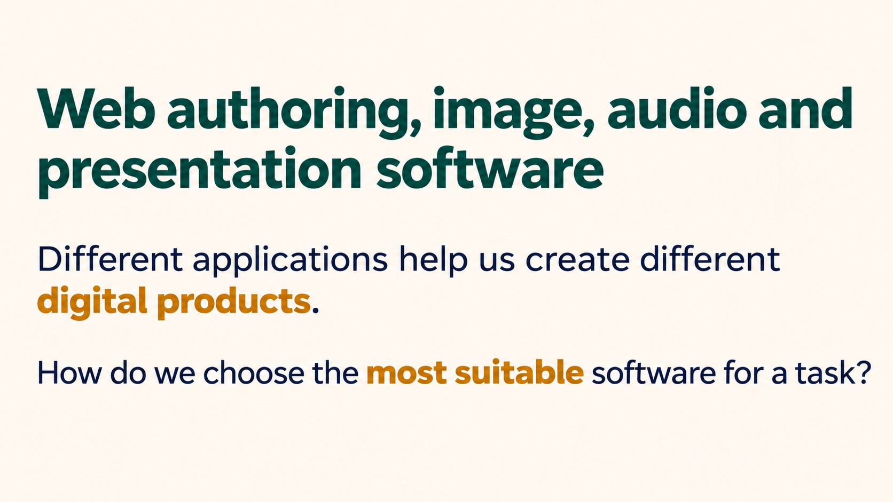
Notes:
Web authoring, image, audio and presentation software
Different applications help us create different digital products.
How do we choose the most suitable software for a task?
Source: Pearson Edexcel International GCSE (9-1) ICT, Unit 1, Chapter 2 Software, printed pages 50-52. Activities adapted for classroom discussion. Slide artwork generated with OpenAI image generation.

Slide 2
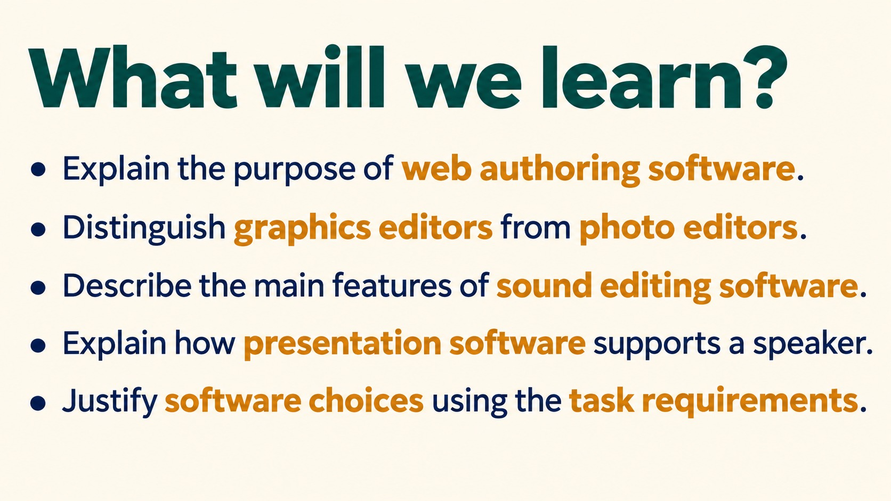
Notes:
What will we learn?
Explain the purpose of web authoring software.
Distinguish graphics editors from photo editors.
Describe the main features of sound editing software.
Explain how presentation software supports a speaker.
Justify software choices using the task requirements.
Source: Pearson Edexcel International GCSE (9-1) ICT, Unit 1, Chapter 2 Software, printed pages 50-52. Activities adapted for classroom discussion. Slide artwork generated with OpenAI image generation.

Slide 3
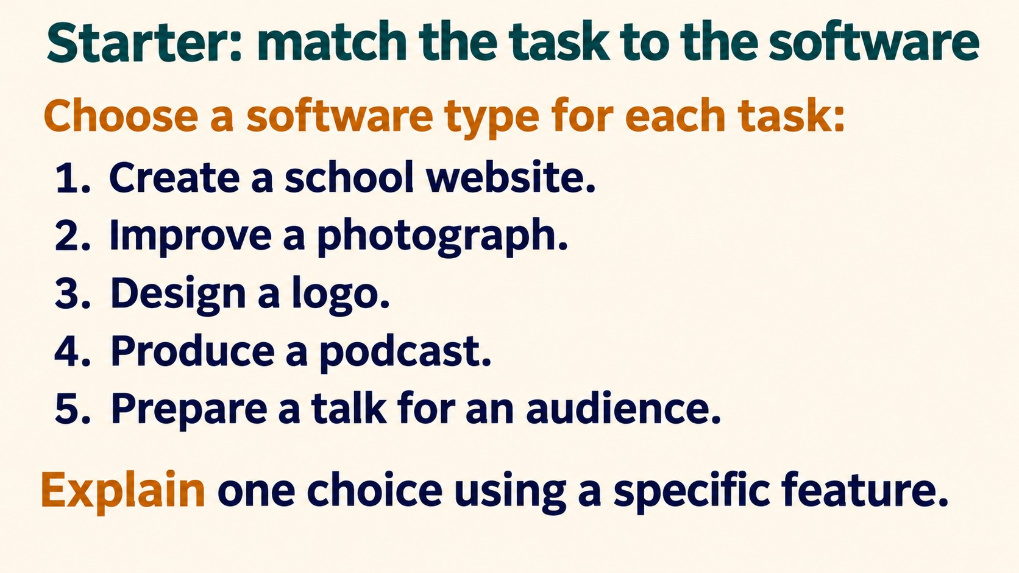
Notes:
Starter: match the task to the software
Choose a software type for each task:
Create a school website.
Improve a photograph.
Design a logo.
Produce a podcast.
Prepare a talk for an audience.
Explain one choice using a specific feature.
Answers: web authoring; photo editing; graphics editing; sound editing; presentation software. Ask for feature and benefit, not just a brand name.
Source: Pearson Edexcel International GCSE (9-1) ICT, Unit 1, Chapter 2 Software, printed pages 50-52. Activities adapted for classroom discussion. Slide artwork generated with OpenAI image generation.

Slide 4
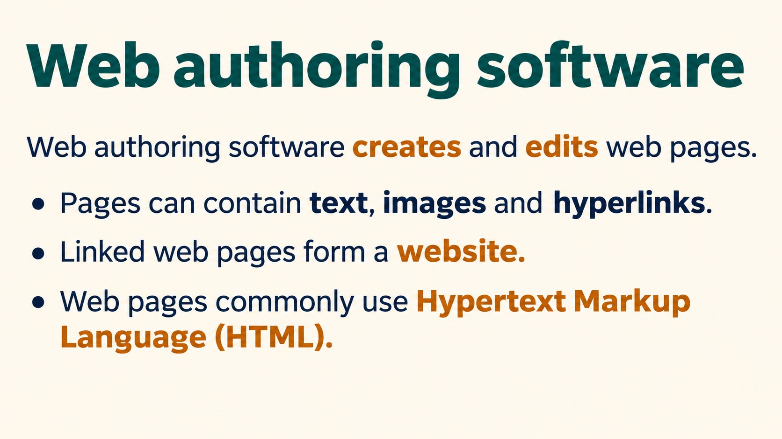
Notes:
Web authoring software
Web authoring software creates and edits web pages.
Pages can contain text, images and hyperlinks.
Linked web pages form a website.
Web pages commonly use Hypertext Markup Language (HTML).
Source: Pearson Edexcel International GCSE (9-1) ICT, Unit 1, Chapter 2 Software, printed pages 50-52. Activities adapted for classroom discussion. Slide artwork generated with OpenAI image generation.

Slide 5
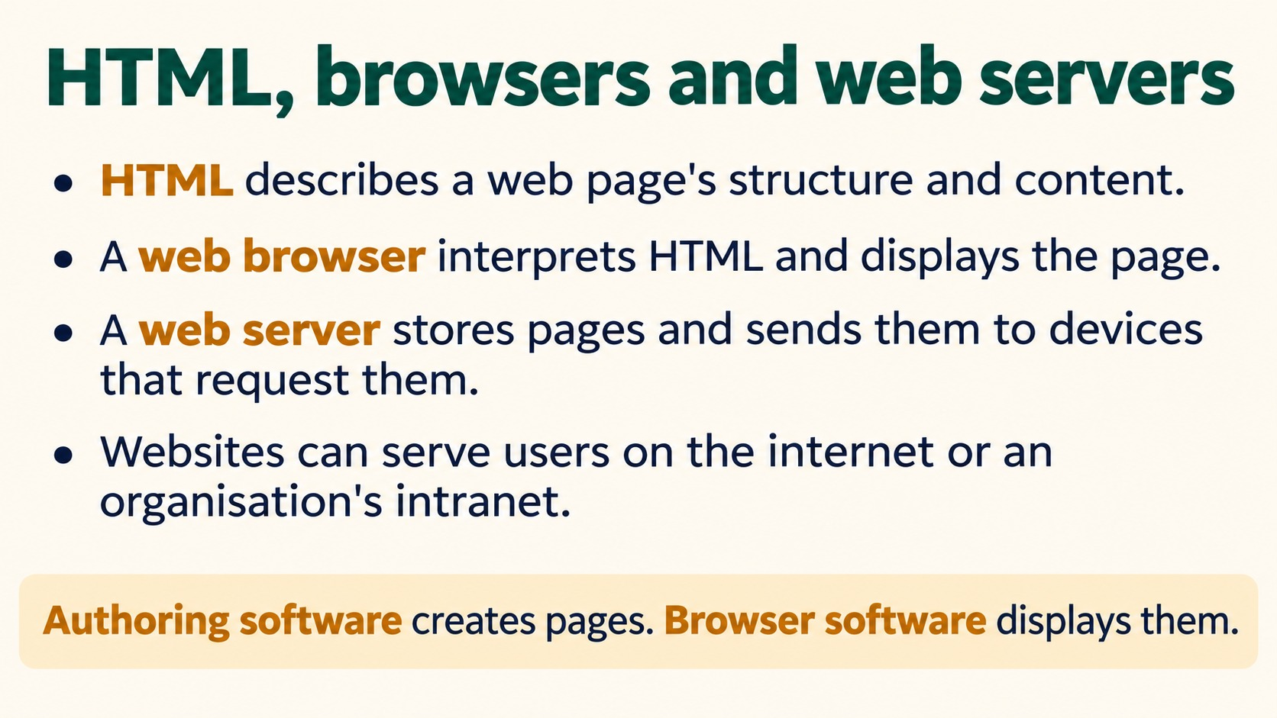
Notes:
HTML, browsers and web servers
HTML describes a web page's structure and content.
A web browser interprets HTML and displays the page.
A web server stores pages and sends them to devices that request them.
Websites can serve users on the internet or an organisation's intranet.
Authoring software creates pages. Browser software displays them.
Source: Pearson Edexcel International GCSE (9-1) ICT, Unit 1, Chapter 2 Software, printed pages 50-52. Activities adapted for classroom discussion. Slide artwork generated with OpenAI image generation.

Slide 6
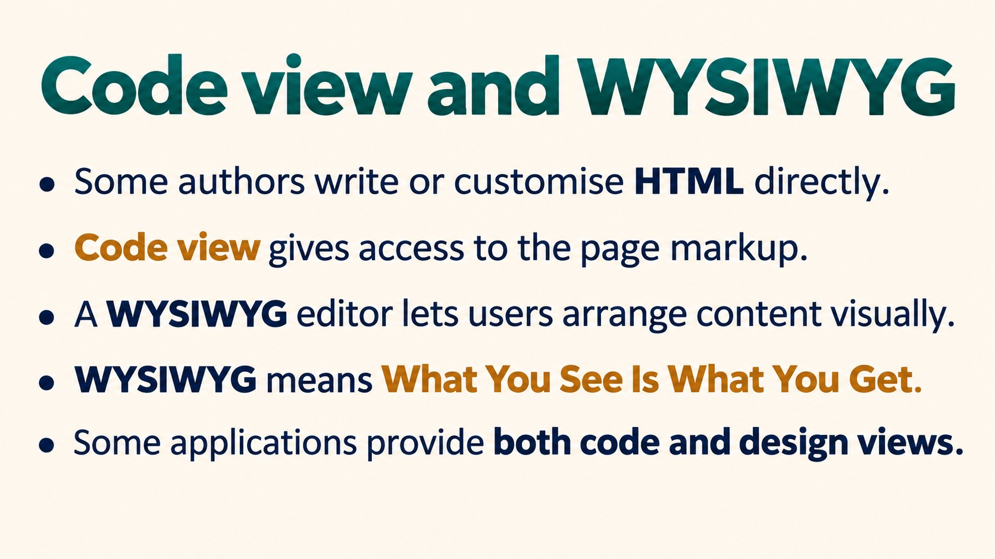
Notes:
Code view and WYSIWYG
Some authors write or customise HTML directly.
Code view gives access to the page markup.
A WYSIWYG editor lets users arrange content visually.
WYSIWYG means What You See Is What You Get.
Some applications provide both code and design views.
Source: Pearson Edexcel International GCSE (9-1) ICT, Unit 1, Chapter 2 Software, printed pages 50-52. Activities adapted for classroom discussion. Slide artwork generated with OpenAI image generation.

Slide 7
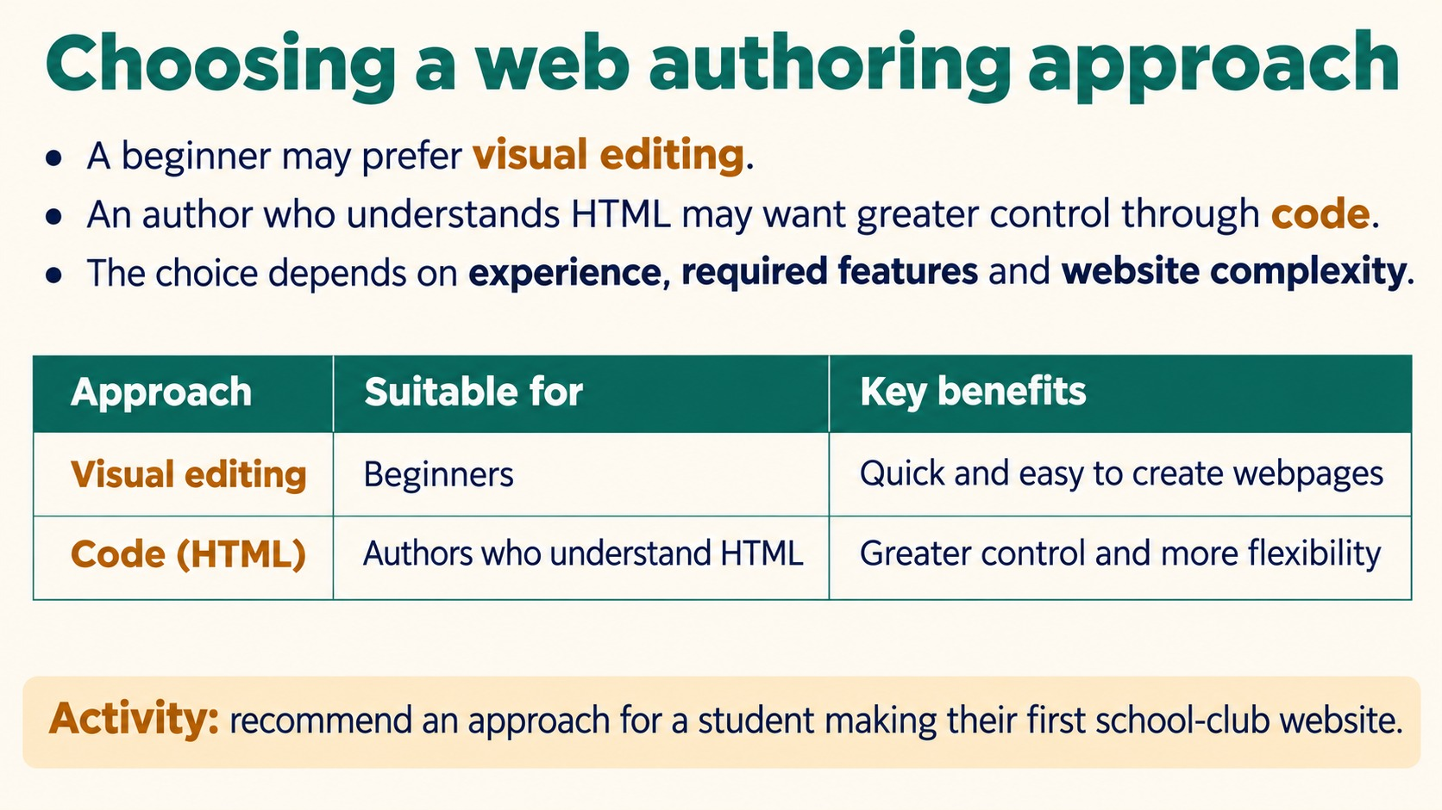
Notes:
Choosing a web authoring approach
A beginner may prefer visual editing.
An author who understands HTML may want greater control through code.
The choice depends on experience, required features and website complexity.
Activity: recommend an approach for a student making their first school-club website.
A justified visual-editor recommendation could explain that direct manipulation reduces the need to know HTML. Accept coding if matched to the student's skills and needs.
Source: Pearson Edexcel International GCSE (9-1) ICT, Unit 1, Chapter 2 Software, printed pages 50-52. Activities adapted for classroom discussion. Slide artwork generated with OpenAI image generation.

Slide 8
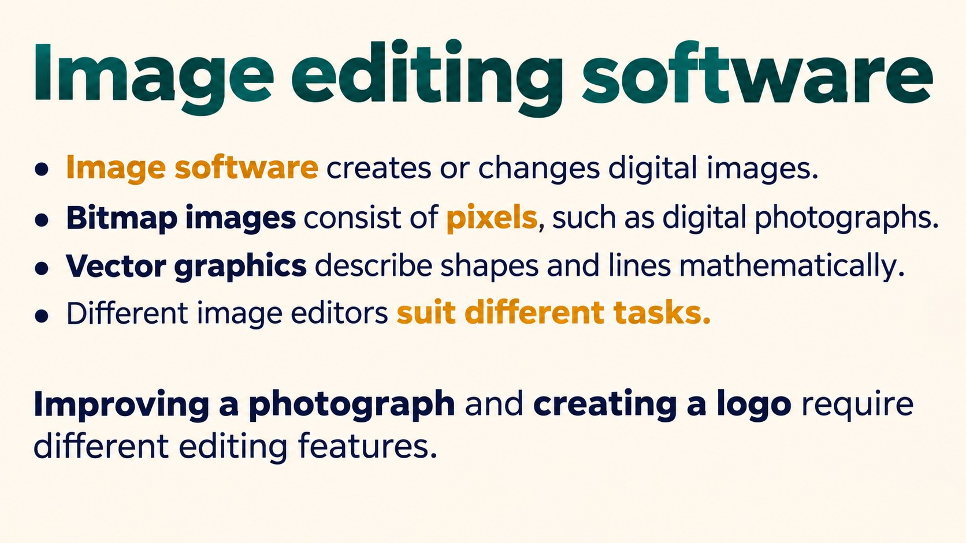
Notes:
Image editing software
Image software creates or changes digital images.
Bitmap images consist of pixels, such as digital photographs.
Vector graphics describe shapes and lines mathematically.
Different image editors suit different tasks.
Improving a photograph and creating a logo require different editing features.
Source: Pearson Edexcel International GCSE (9-1) ICT, Unit 1, Chapter 2 Software, printed pages 50-52. Activities adapted for classroom discussion. Slide artwork generated with OpenAI image generation.

Slide 9
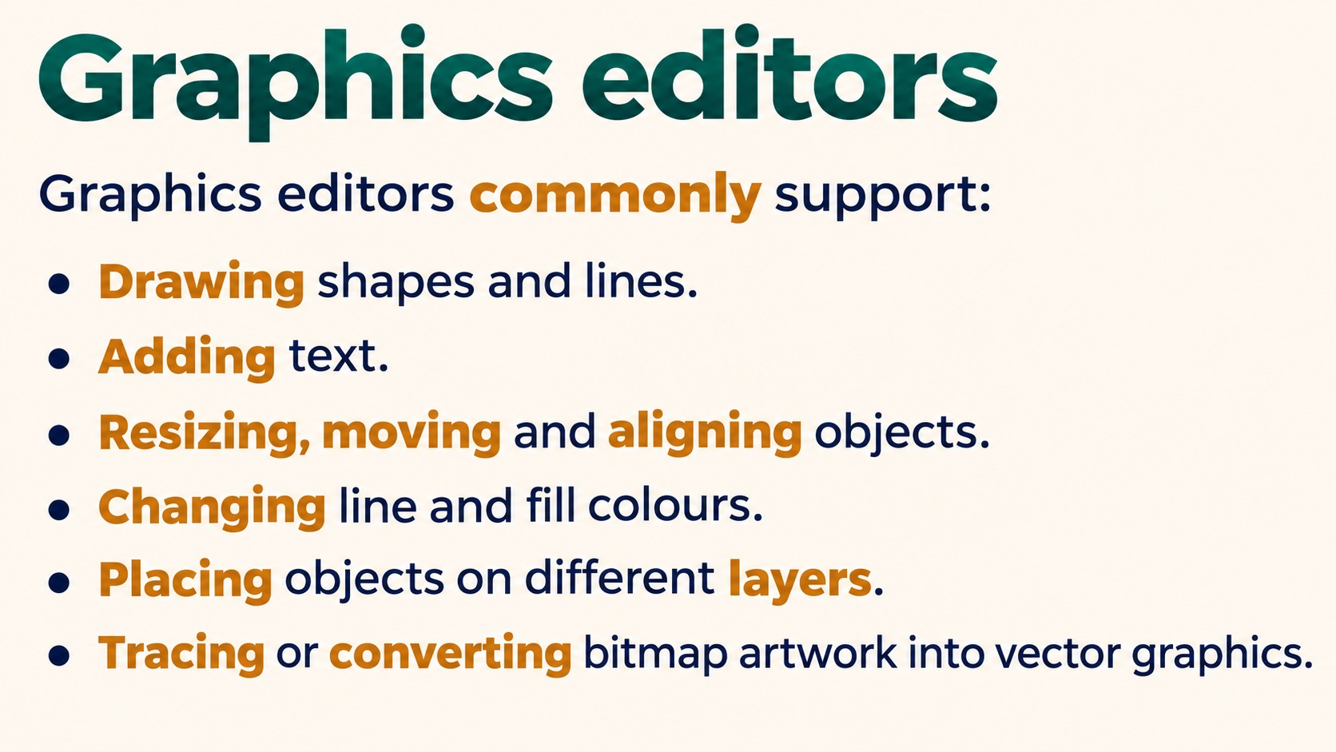
Notes:
Graphics editors
Graphics editors commonly support:
Drawing shapes and lines.
Adding text.
Resizing, moving and aligning objects.
Changing line and fill colours.
Placing objects on different layers.
Tracing or converting bitmap artwork into vector graphics.
Source: Pearson Edexcel International GCSE (9-1) ICT, Unit 1, Chapter 2 Software, printed pages 50-52. Activities adapted for classroom discussion. Slide artwork generated with OpenAI image generation.

Slide 10
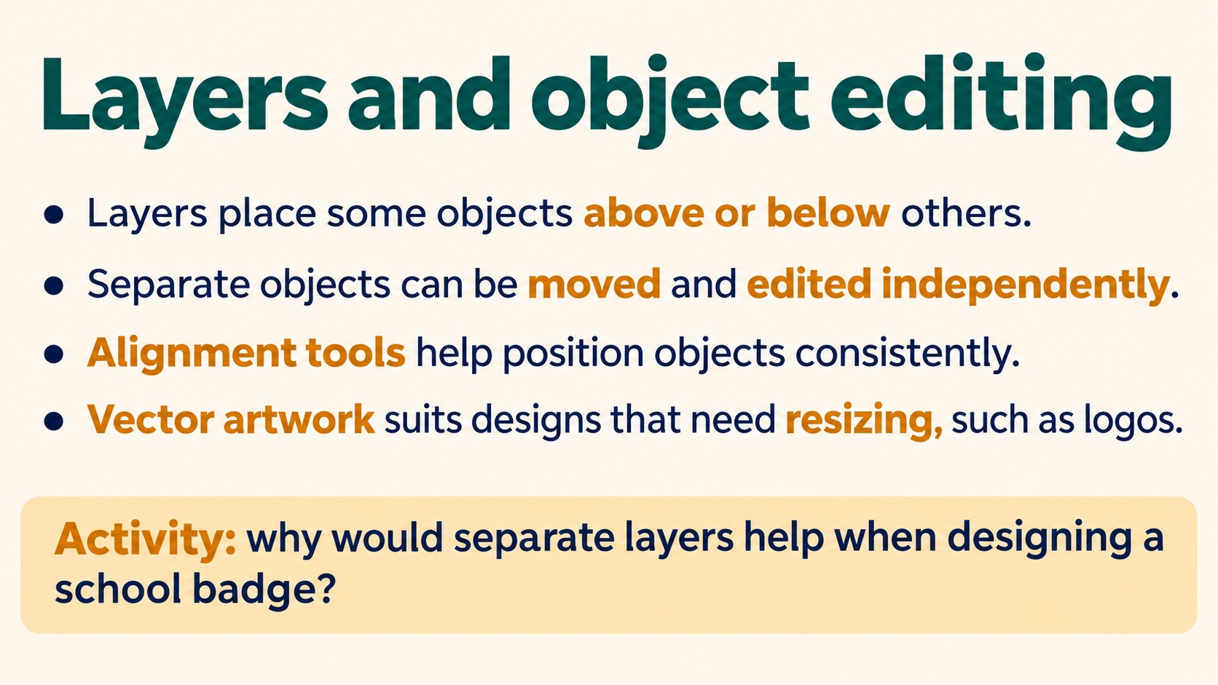
Notes:
Layers and object editing
Layers place some objects above or below others.
Separate objects can be moved and edited independently.
Alignment tools help position objects consistently.
Vector artwork suits designs that need resizing, such as logos.
Activity: why would separate layers help when designing a school badge?
Example: move the text without moving the badge outline, or place a symbol behind the text.
Source: Pearson Edexcel International GCSE (9-1) ICT, Unit 1, Chapter 2 Software, printed pages 50-52. Activities adapted for classroom discussion. Slide artwork generated with OpenAI image generation.

Slide 11
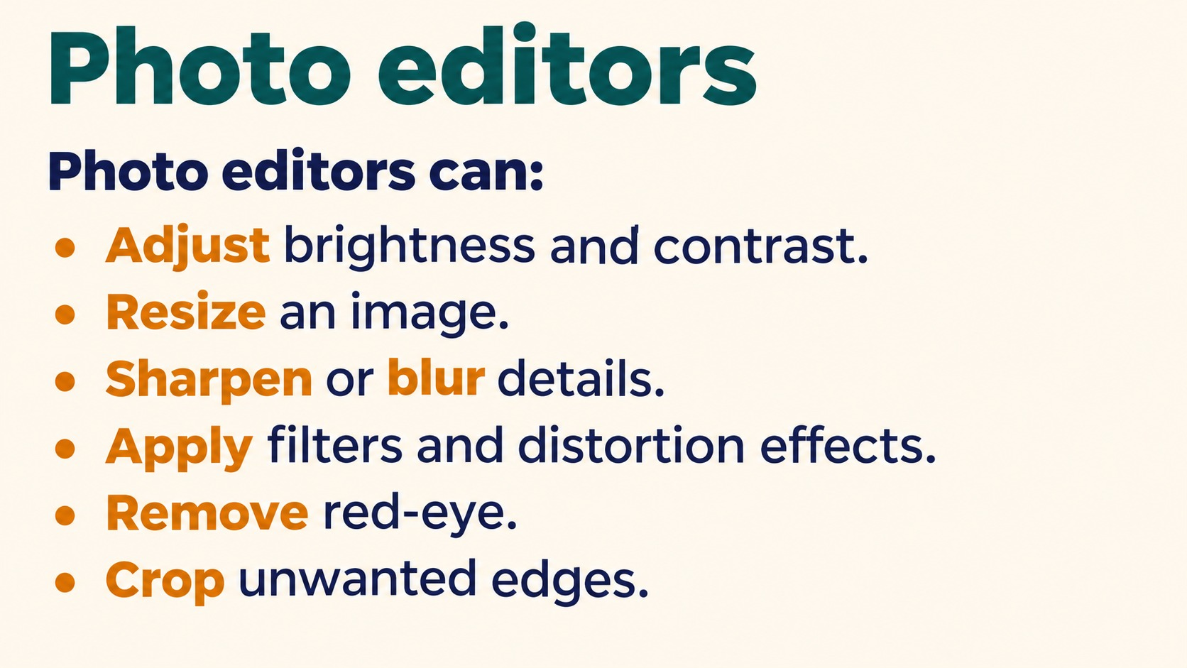
Notes:
Photo editors
Photo editors can:
Adjust brightness and contrast.
Resize an image.
Sharpen or blur details.
Apply filters and distortion effects.
Remove red-eye.
Crop unwanted edges.
Source: Pearson Edexcel International GCSE (9-1) ICT, Unit 1, Chapter 2 Software, printed pages 50-52. Activities adapted for classroom discussion. Slide artwork generated with OpenAI image generation.

Slide 12
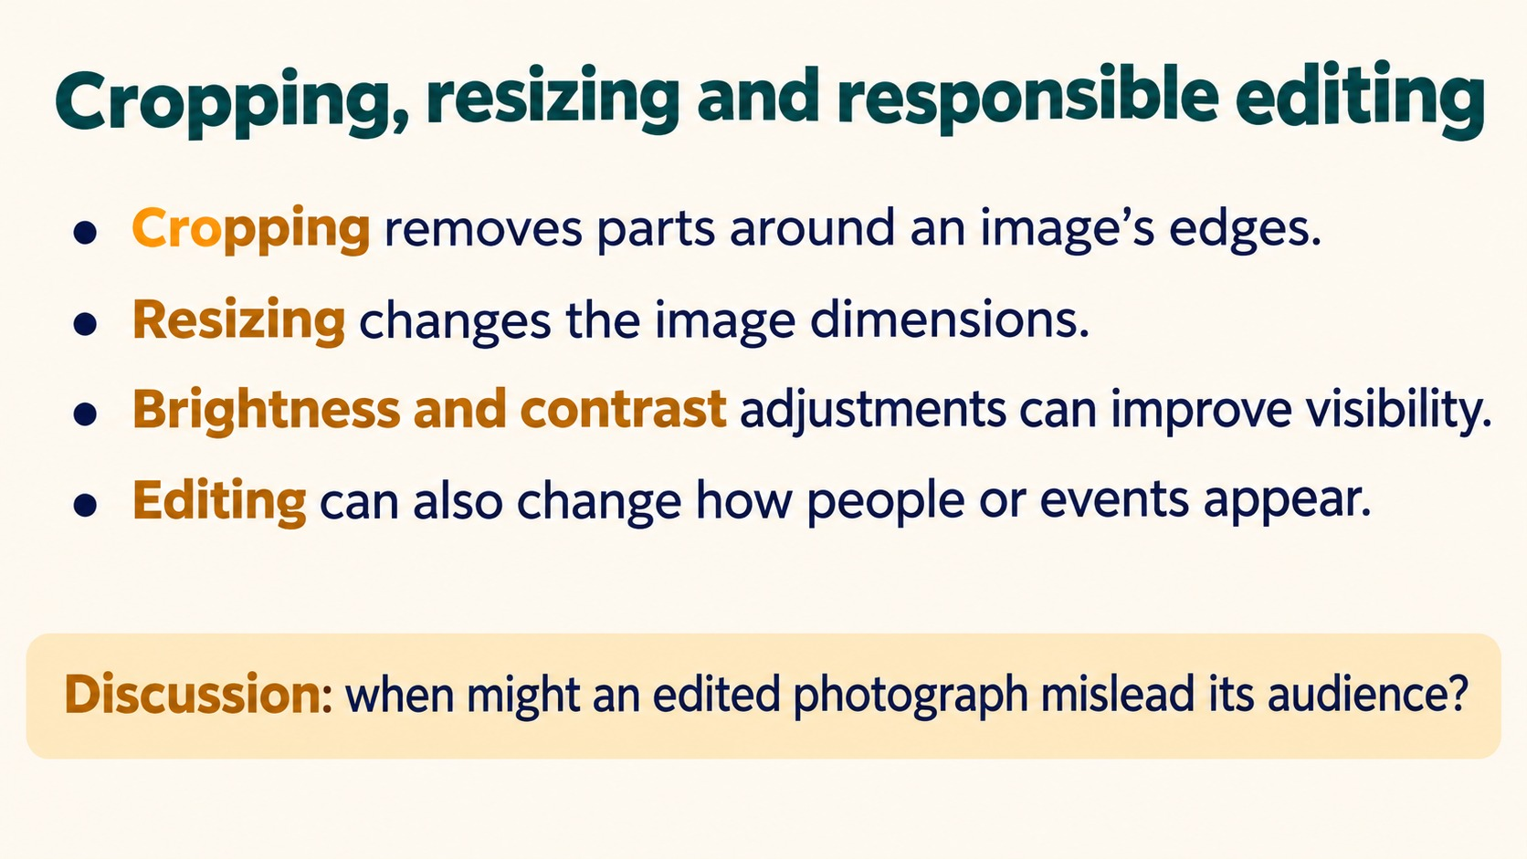
Notes:
Cropping, resizing and responsible editing
Cropping removes parts around an image's edges.
Resizing changes the image dimensions.
Brightness and contrast adjustments can improve visibility.
Editing can also change how people or events appear.
Discussion: when might an edited photograph mislead its audience?
Link to the book's discussion of image editing in the beauty industry. Examples: altering body shape or removing contextual evidence. Distinguish useful enhancement from misleading representation.
Source: Pearson Edexcel International GCSE (9-1) ICT, Unit 1, Chapter 2 Software, printed pages 50-52. Activities adapted for classroom discussion. Slide artwork generated with OpenAI image generation.

Slide 13
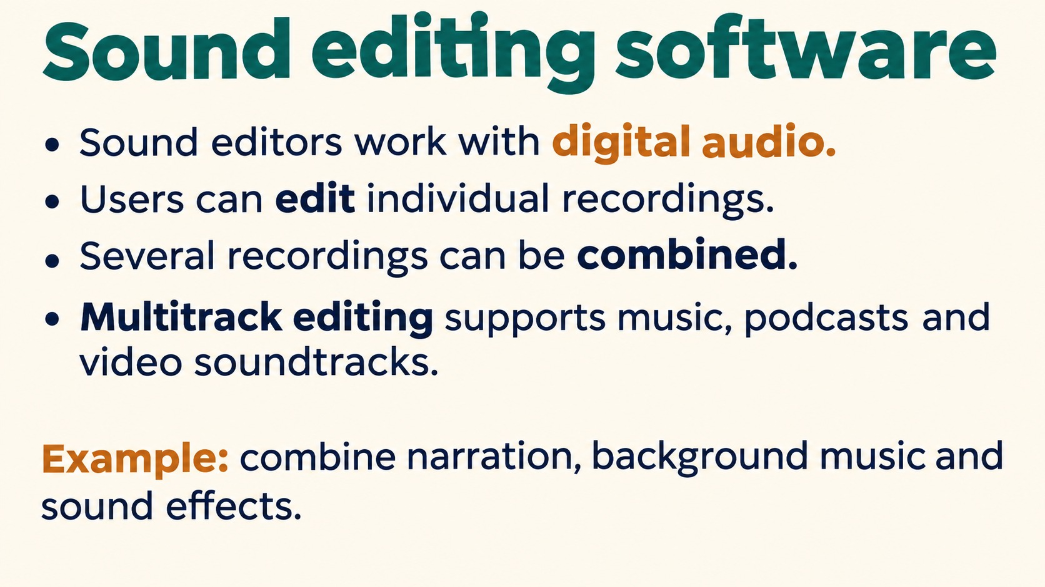
Notes:
Sound editing software
Sound editors work with digital audio.
Users can edit individual recordings.
Several recordings can be combined.
Multitrack editing supports music, podcasts and video soundtracks.
Example: combine narration, background music and sound effects.
Source: Pearson Edexcel International GCSE (9-1) ICT, Unit 1, Chapter 2 Software, printed pages 50-52. Activities adapted for classroom discussion. Slide artwork generated with OpenAI image generation.

Slide 14
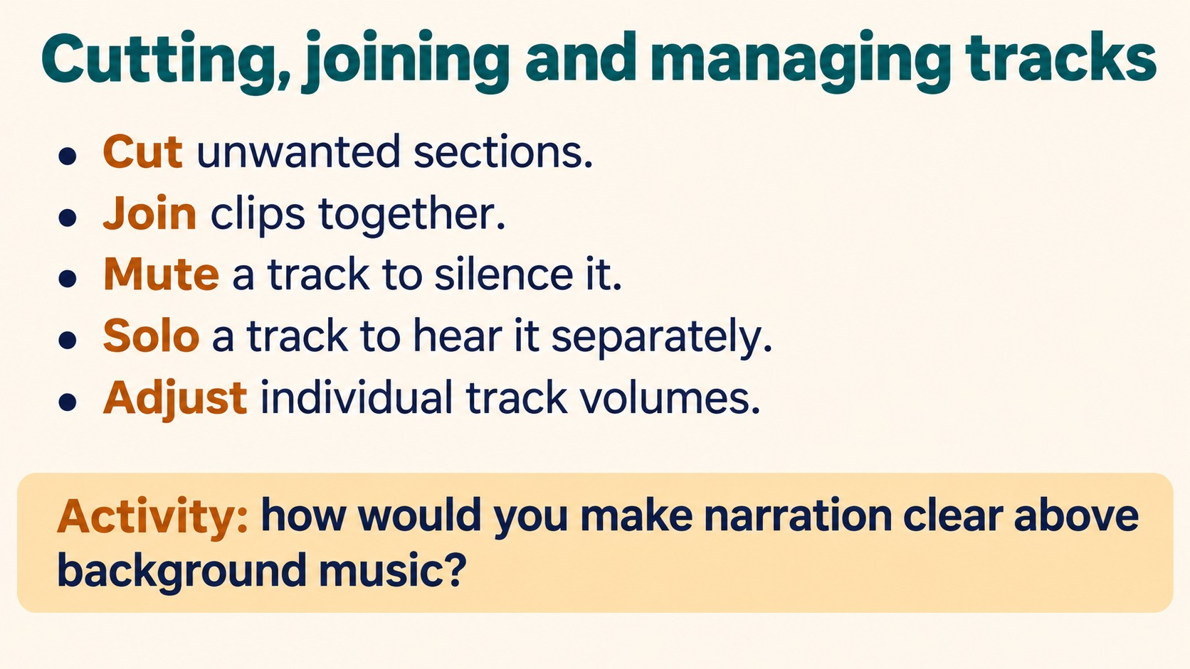
Notes:
Cutting, joining and managing tracks
Cut unwanted sections.
Join clips together.
Mute a track to silence it.
Solo a track to hear it separately.
Adjust individual track volumes.
Activity: how would you make narration clear above background music?
Lower the music track level or raise narration appropriately without distortion. Solo helps inspect narration, but does not itself create the final mix.
Source: Pearson Edexcel International GCSE (9-1) ICT, Unit 1, Chapter 2 Software, printed pages 50-52. Activities adapted for classroom discussion. Slide artwork generated with OpenAI image generation.

Slide 15
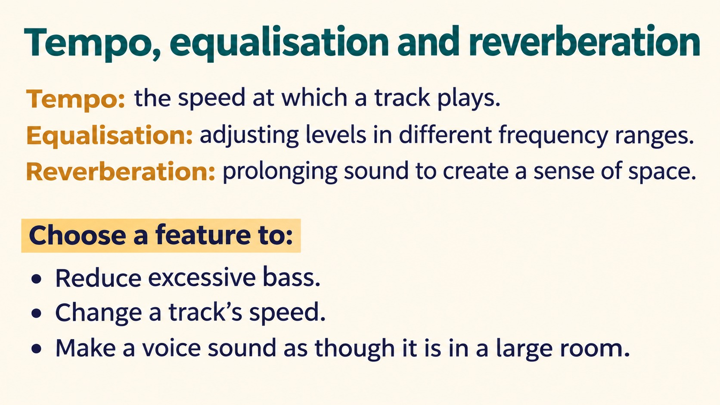
Notes:
Tempo, equalisation and reverberation
Tempo: the speed at which a track plays.
Equalisation: adjusting levels in different frequency ranges.
Reverberation: prolonging sound to create a sense of space.
Choose a feature to:
Reduce excessive bass.
Change a track's speed.
Make a voice sound as though it is in a large room.
Answers: equalisation; tempo adjustment; reverberation.
Source: Pearson Edexcel International GCSE (9-1) ICT, Unit 1, Chapter 2 Software, printed pages 50-52. Activities adapted for classroom discussion. Slide artwork generated with OpenAI image generation.

Slide 16
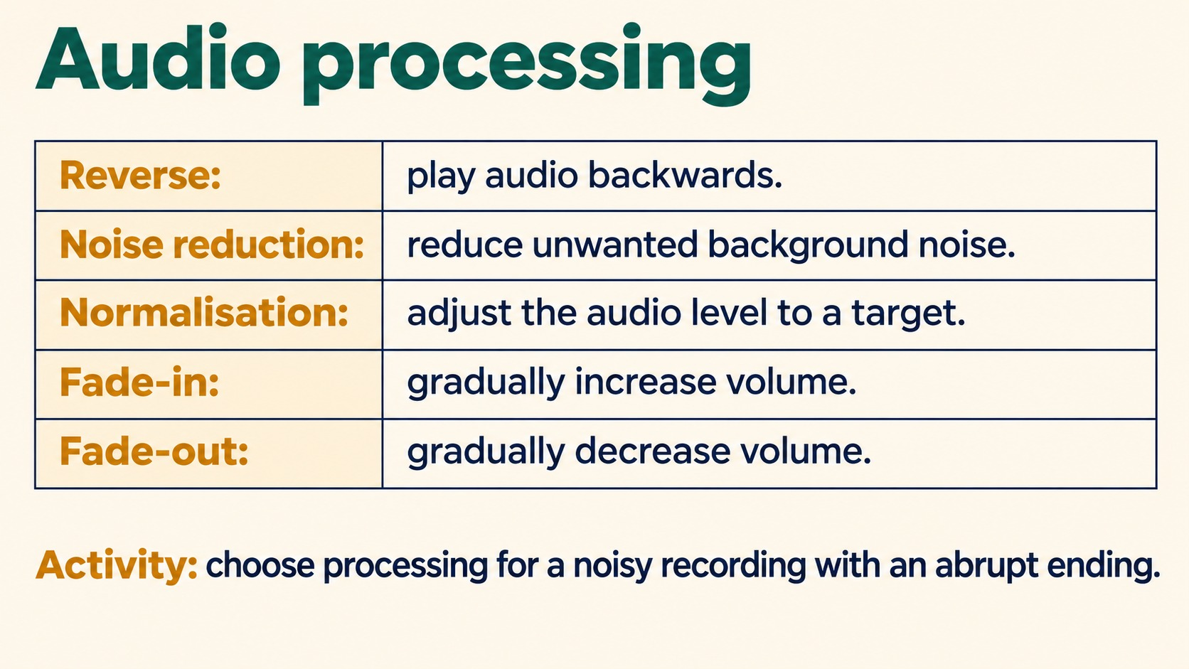
Notes:
Audio processing
Reverse: play audio backwards.
Noise reduction: reduce unwanted background noise.
Normalisation: adjust the audio level to a target.
Fade-in: gradually increase volume.
Fade-out: gradually decrease volume.
Activity: choose processing for a noisy recording with an abrupt ending.
Noise reduction for background noise; fade-out for the ending. Normalisation adjusts level, rather than removing noise.
Source: Pearson Edexcel International GCSE (9-1) ICT, Unit 1, Chapter 2 Software, printed pages 50-52. Activities adapted for classroom discussion. Slide artwork generated with OpenAI image generation.

Slide 17
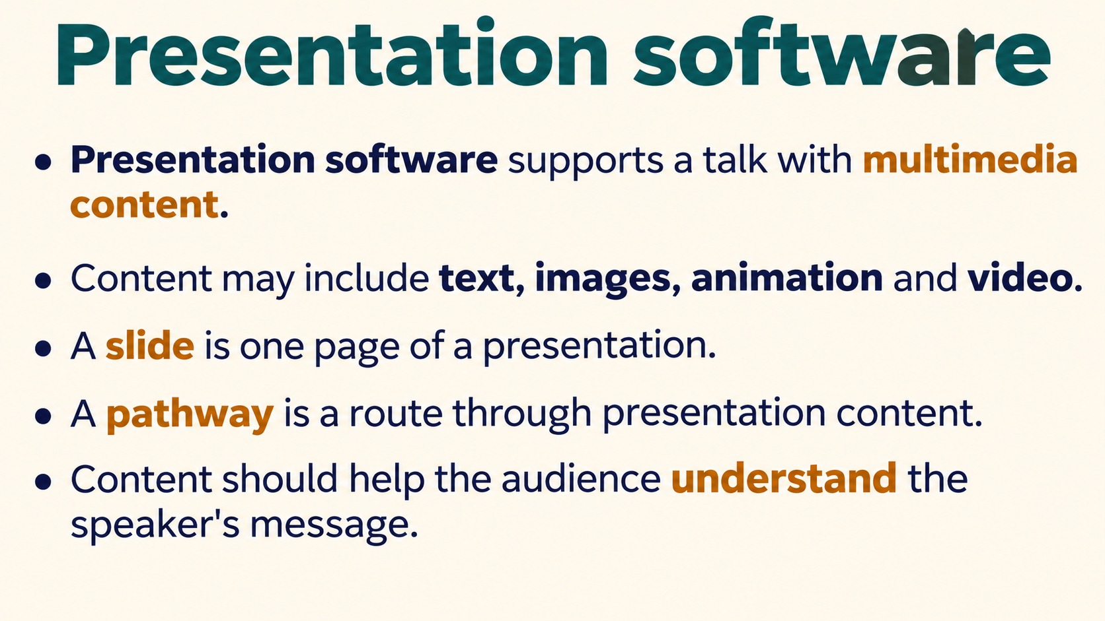
Notes:
Presentation software
Presentation software supports a talk with multimedia content.
Content may include text, images, animation and video.
A slide is one page of a presentation.
A pathway is a route through presentation content.
Content should help the audience understand the speaker's message.
Source: Pearson Edexcel International GCSE (9-1) ICT, Unit 1, Chapter 2 Software, printed pages 50-52. Activities adapted for classroom discussion. Slide artwork generated with OpenAI image generation.

Slide 18
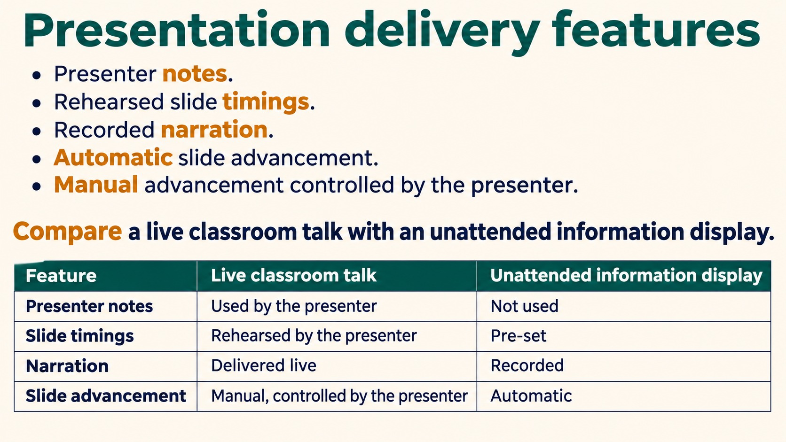
Notes:
Presentation delivery features
Presenter notes.
Rehearsed slide timings.
Recorded narration.
Automatic slide advancement.
Manual advancement controlled by the presenter.
Compare a live classroom talk with an unattended information display.
A live talk can use presenter notes and manual advancement. An unattended display can use narration, timings and automatic advancement.
Source: Pearson Edexcel International GCSE (9-1) ICT, Unit 1, Chapter 2 Software, printed pages 50-52. Activities adapted for classroom discussion. Slide artwork generated with OpenAI image generation.

Slide 19
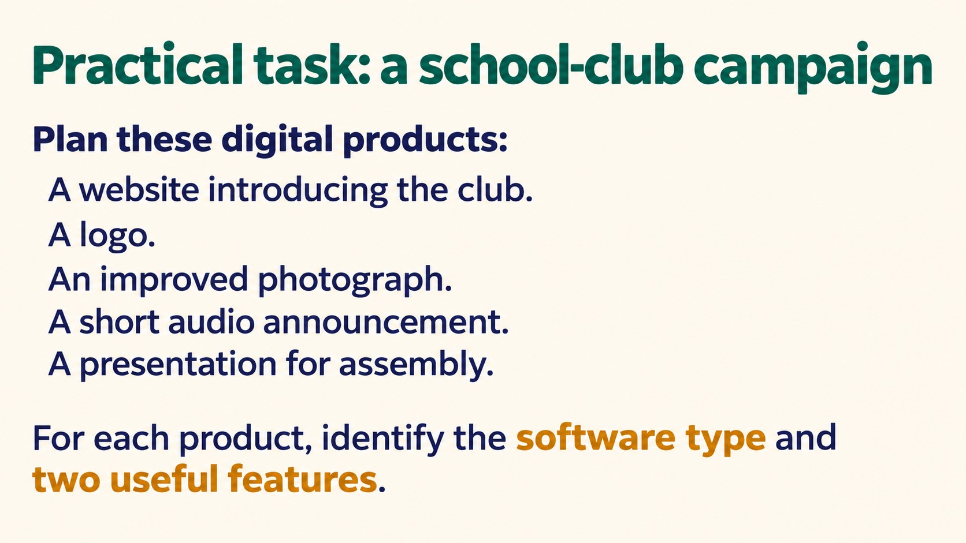
Notes:
Practical task: a school-club campaign
Plan these digital products:
A website introducing the club.
A logo.
An improved photograph.
A short audio announcement.
A presentation for assembly.
For each product, identify the software type and two useful features.
Source: Pearson Edexcel International GCSE (9-1) ICT, Unit 1, Chapter 2 Software, printed pages 50-52. Activities adapted for classroom discussion. Slide artwork generated with OpenAI image generation.

Slide 20
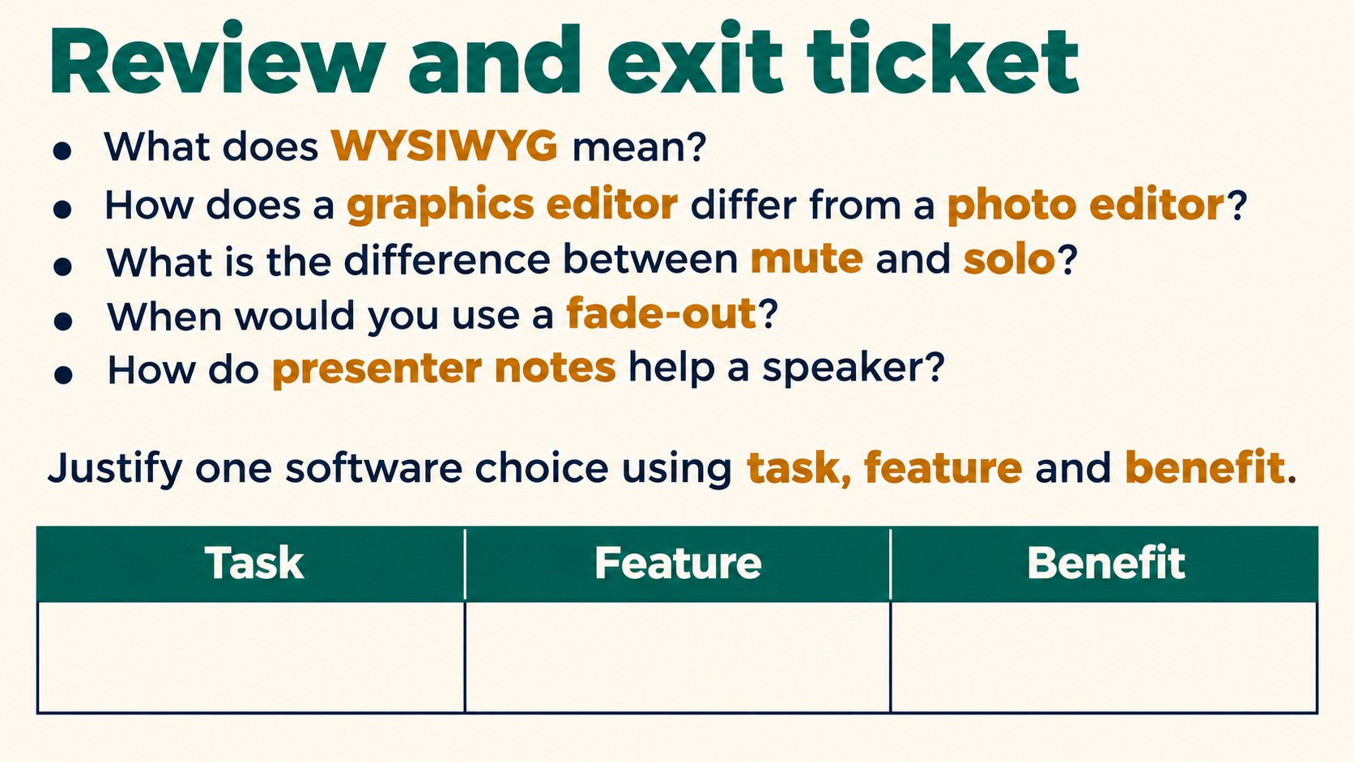
Notes:
Review and exit ticket
What does WYSIWYG mean?
How does a graphics editor differ from a photo editor?
What is the difference between mute and solo?
When would you use a fade-out?
How do presenter notes help a speaker?
Justify one software choice using task, feature and benefit.
Exam reminder: identify a software type and explain why its features meet the scenario requirements, rather than relying only on a product name.
Source: Pearson Edexcel International GCSE (9-1) ICT, Unit 1, Chapter 2 Software, printed pages 50-52. Activities adapted for classroom discussion. Slide artwork generated with OpenAI image generation.

